Slide 1
Python-Powered Analytics in Excel: Leveling Up Skills for Management Scholars and Educators
Justin Keeler, Wichita State University
Clinical Associate Professor of Business Analytics
SWAM Conference 2024
Moody Gardens Convention Center
Galveston, Texas
Wednesday, April 10th, 2024

Slide 2
Why this workshop?
“If we teach today as we taught yesterday, we rob our children of tomorrow.” – John Dewey
It is a step to bridge the gap between traditional analysis and modern computational techniques with a focus in management
Objective: To introduce, demonstrate, encourage participation, and familiarize attendees with Python integration in Excel considerations.

Slide 3
Who is the intended audience?
This workshop's intended audience includes management scholars, students, faculty, and professionals interested in enhancing analytical skills with a new “Python” feature integrated into a beta version of Excel.
You might be an enthusiast of business intelligence tools looking to expand your data analysis toolkit.
You might be a decision-maker seeking to leverage Python's capabilities for more informed management.
Possibly, you are an instructor aiming to incorporate cutting-edge technology into your curriculum, given the advances of AI.

Slide 4
Agenda
Introduction and Getting Started
Python vs. Excel in Advanced Analytics
10-Minute Break
Hands-on Python Practice in Excel for Management
Libraries, Applications, and Closing

Slide 5
Introduction & Getting Started: Python Language, a Refresher | Part 1
Successor to ABC language by Guido van Rossum (Netherlands), first released in 1991.
Name is inspired by Monty Python.
Python is an object-oriented and interpreted language.
Think of it as an analytic Swiss Army Knife. Why?
With access to different libraries, it provides utility for an array of purposes.

Slide 6
Introduction & Getting Started: Python IDEs, a Refresher | Part 2
Integrated Development Environments (IDEs) serve the primary purposes of code editing, writing, testing, and debugging.
Purposes
Prototyping: Jupyter Notebooks, Google Colab, Spyder
Deployment: PyCharm, Visual Studio
Hybrid for both: Visual Studio Code (VS Code)
Syntax Highlighting & Code Completion
Integration with Other Frameworks
Django, Streamlit, Anvil, etc. for Web Applications…

Slide 7
Introduction & Getting Started: Setup & Activating the Python Add-in | Part 1
Step 1: You need to opt into using the Excel Beta Version and refresh the setup
This only works if you have Office 365.
Necessary because Python code is processed from within Microsoft Cloud.
There is no fee at this time.

Slide 8
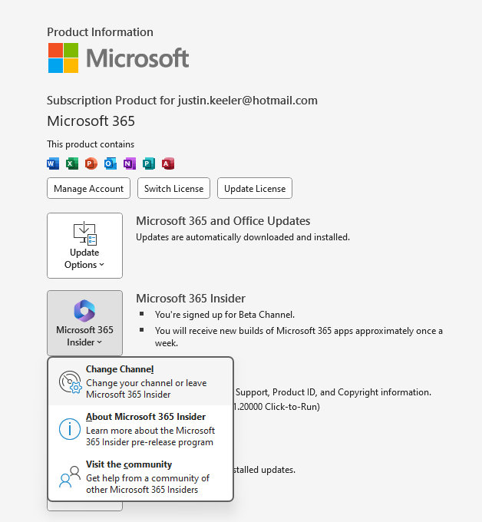
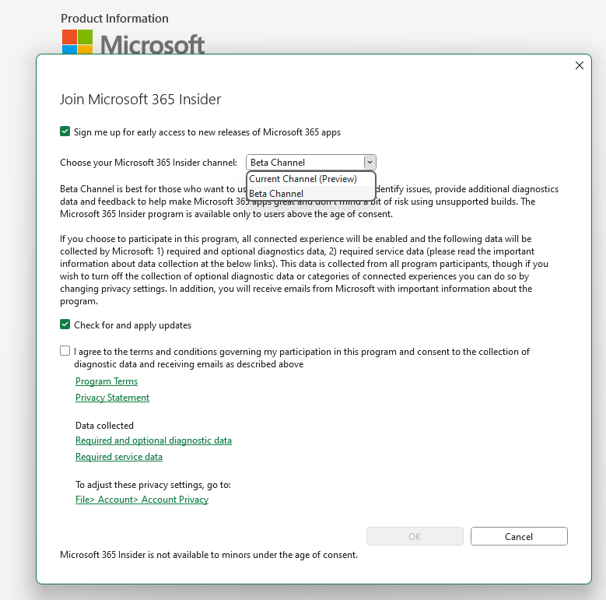
Introduction & Getting Started: Setup & Activating the Python Add-in | Part 2

Slide 9
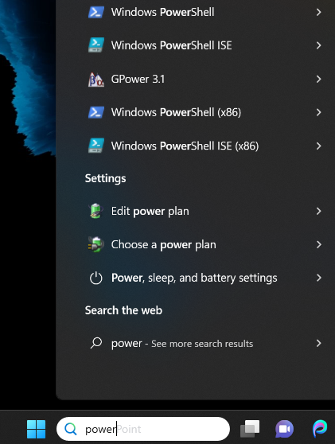
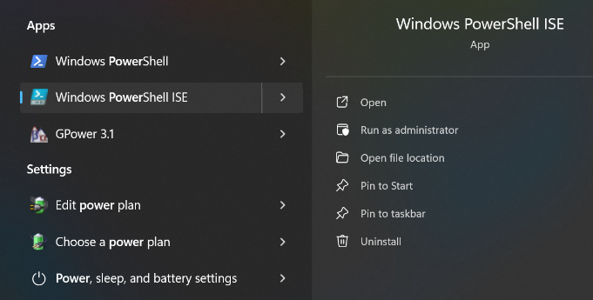
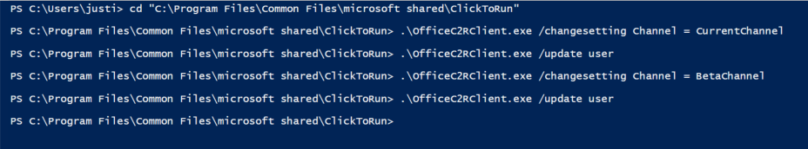
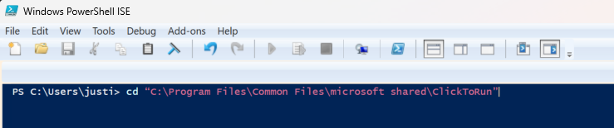
Introduction & Getting Started: Setup & Activating the Python Add-in | Part 3
Refresh via Powershell ISE to Update User Settings
1: Search for Powershell ISE
2: Open Prompt
4: Update User Settings
.\OfficeC2RClient.exe /changesetting Channel = CurrentChannel <enter>
.\OfficeC2RClient.exe /update user <enter>
.\OfficeC2RClient.exe /changesetting Channel = BetaChannel <enter>
.\OfficeC2RClient.exe /update user <enter>
Was in Beta, changed to Current and back to Beta
3: Change Directory
cd “C:\Program Files\Common Files\microsoft shared\ClickToRun” <enter>

Slide 10
Python vs. Excel for Management Analytics: Advantages of Python over Excel | Part 1
Large Data Processing
Excel maximizes out at around 1,048,576 rows by 16,348 columns, whereas Python is limited more by computer RAM than data size.
Advanced Analytics
Excel’s Data Analysis (Add-in) provides utility but is limited for training/validation/testing of models, KNN, logistic regression, etc.

Slide 11
Python vs. Excel for Management Analytics: Advantages of Python over Excel | Part 2
Automation & Reproducibility
Once a Python script is written, it can be used to automate repetitive tasks and perform analyses. We will see this with my Example 2 a little later.
Collaboration & Version Control
Python code is sharable, especially via systems like Git or GitHub, similar to what I have provided for this workshop. Excel files are binary, they are hard to track changes.

Slide 12
Python vs. Excel for Management Analytics: Python Integration into Excel – Benefits | Part 1
Python code will stay embedded within the Excel file and accessible if another version opens it.
Provides a dynamic experience to interact with Python syntax (contained within a cell as a form of a code block) rather than line-by-line like IDEs.
Allows access to advanced modeling techniques previously mentioned (KNN, logistic regression, SVM, etc.).
Useful

Slide 13
Python vs. Excel for Management Analytics: Python Integration into Excel – Benefits | Part 2
Generating the descriptives using df.describe() results in normal output; however, in Excel, you can adjust the decimals of the cells w/o round or format.
Convenient to collapse and expand analytical outputs from Python objects to Excel values by toggling using the shortcut of [ctrl alt shift m].
Visibility of library functions and function parameters is the same as regular Python, e.g., dir(pd) and help(pd.merge).

Slide 14
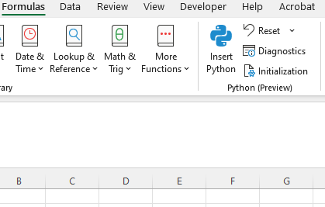
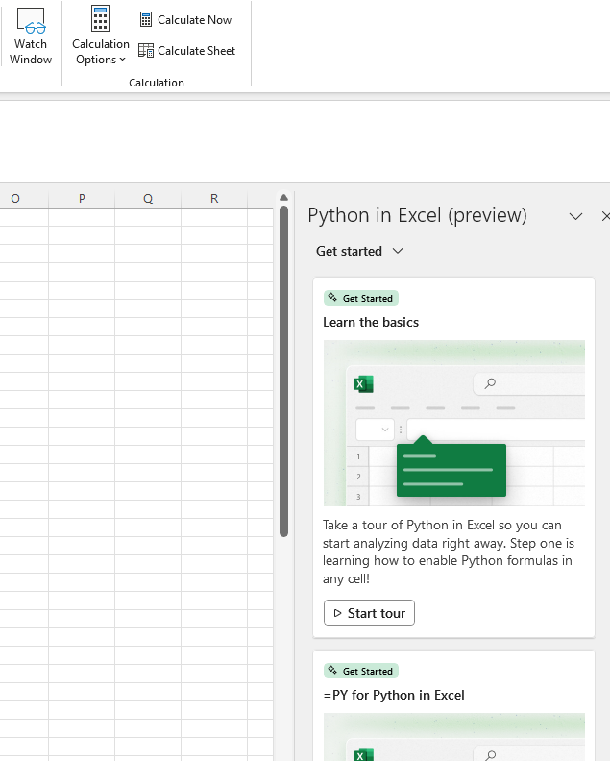
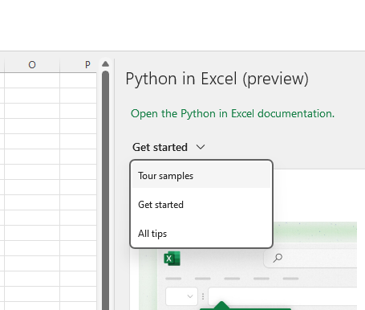
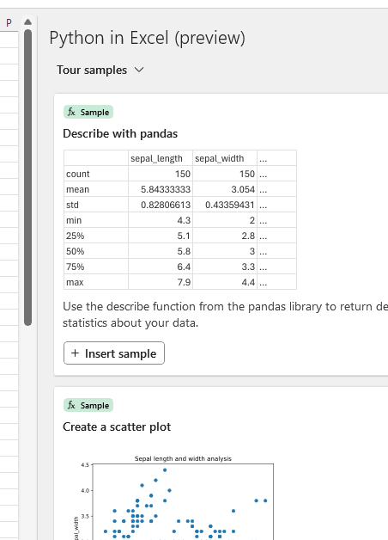
Python vs. Excel for Management Analytics: Python Integration into Excel – Benefits | Part 3
User-friendly tutorial access to learn Python functions and libraries.

Slide 15
Python vs. Excel for Management Analytics: Python Integration into Excel – Downsides | Part 1
Python code is processed on Microsoft servers. This means your data is submitted, processed, and displayed back to you. Think dumb terminal, potential data breach/security issues.
No Internet access, means no access to the Python add-in. Similarly, think of Google Colab IDE for comparison.
Some simple tasks do not perform well within Excel’s Python extension/add-in e.g. df3 = pd.merge(df1, df2, on=“key”, how=“left”)

Slide 16
Python vs. Excel for Management Analytics: Python Integration into Excel – Downsides | Part 2
You can get a spill error, which means there is data in a cell Python is trying to use (the value in the cell needs to be cleared for output to generate).
Visualizations are somewhat clunky; you need to resize cells and/or merge them, then cross reference for image generation.
Not all Python libraries are available to import, which could limit analytic techniques.
Tuples and multi objects are problematic (will be seen in our Example 1):
overall_average_salary, average_salary_by_department

Slide 17
Python vs. Excel for Management Analytics: Python Libraries| Part 1
Initialization in Excel (pre-loaded)
import numpy as np
import pandas as pd
import matplotlib.pyplot as plt
import statsmodels as sm
import seaborn as sns
import excel
import warnings warnings.simplefilter('ignore’)
# Set default conversions for the xl() function. excel.set_xl_scalar_conversion(excel.convert_to_scalar) excel.set_xl_array_conversion(excel.convert_to_dataframe)

Slide 18
Python vs. Excel for Management Analytics: Python Libraries| Part 2
Other libraries that can be called into Excel
import statsmodels.api as sm #access to 45 functions in module
import network as nx #access to 736 functions in module
from sklearn.model_selection import train_test_split
# Assuming X is your feature set and y is your target variableX_train, X_test, y_train, y_test = train_test_split(X, y, test_size=0.2, random_state=42)
Note: The above list is not exhaustive. While pip installs are not performed in Excel for Python packages (libraries), this add-in is beta. It is not feasible for the tens of thousands of packages to be accessible or preloaded.

Slide 19
10-Minute Break
Shared Google Colab
https://github.com/justinbkeeler/swam2024_pdw/blob/main/SWAM_2024_PDW_Python_%26_Excel_Integration.ipynb

Slide 20
Hands-on Python Practice in Excel for Mgmt. Example 1: Employee Salary Analysis
Practical Questions
What is the average annual salary per department, and how does it vary with years spent at the company?
Can we visualize the distribution of annual salaries across the company to see if there are any patterns or outliers?
How does job satisfaction relate to annual salary, and are there differences in this relationship between departments?

Slide 21
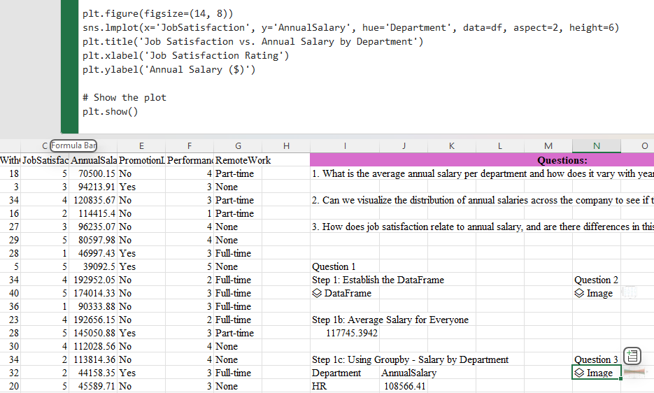
Hands-on Python Practice in Excel for Mgmt. Example 1: Employee Salary Analysis

Slide 22
Hands-on Python Practice in Excel for Mgmt. Example 2: Analyzing Student Exam Performance
Practical Question
Does the exam average differ from one class section compared to another section?

Slide 23
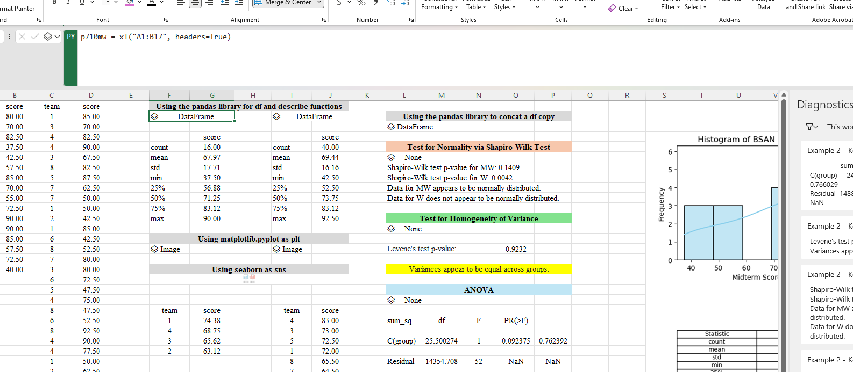
Hands-on Python Practice in Excel for Mgmt. Example 2: Analyzing Student Exam Performance

Slide 24
Hands-on Python Practice in Excel for Mgmt. Example 3: Team Dynamics Visualization
Practical Question
Who are the top/key influencers?
Who are the communication bottlenecks?
What are some of the subgroups and/or communicates? Is anyone isolated?

Slide 25
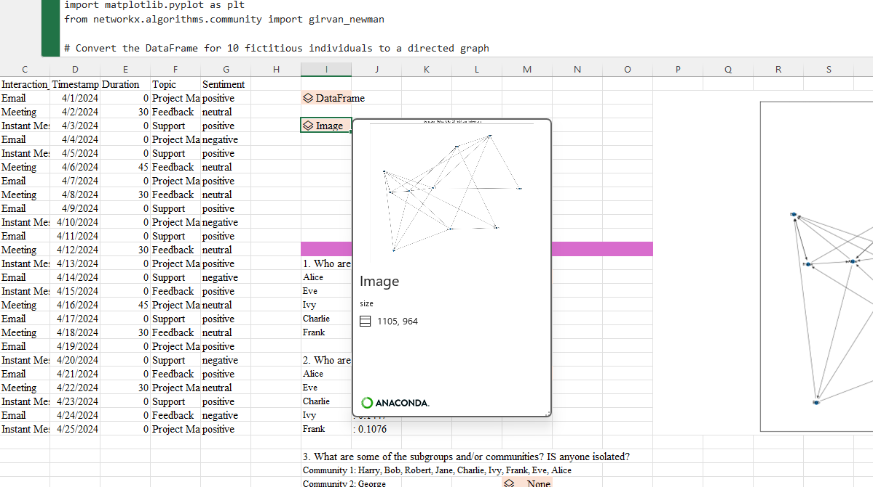
Hands-on Python Practice in Excel for Mgmt. Example 3: Team Dynamics Visualization

Slide 26
Usage & Applications In Class HR, OB, & Management | Part 1
1) Employee Performance Analysis (HR)
Scenario: HR students can use Python to analyze employee performance data, including productivity metrics, attendance records, and performance reviews.
Python Application: By using libraries like Pandas for data manipulation and Matplotlib or Seaborn for visualization, students can identify patterns of high and low performance, analyze the impact of training programs, and predict future performance based on historical data.
2) Predictive Modeling for HR Decisions (HR)
Scenario: Students can be tasked with creating predictive models to aid in HR decision-making, such as forecasting staffing needs or the likelihood of employee attrition.
Python Application: Machine learning libraries like scikit-learn or TensorFlow can be used to build and train models on historical data, allowing students to make informed predictions about future HR needs.

Slide 27
Usage & Applications In Class HR, OB, & Management | Part 2
3) Analysis of Organizational Networks (OB)
Scenario: In organizational behavior classes, analyzing communication patterns and networks within an organization can provide insights into how information flows, how collaborative networks are structured, and how silos form.
Python Application: Network analysis libraries such as NetworkX allow for the visualization and analysis of complex networks, helping students to understand the dynamics of organizational structures and relationships.
4) Leadership Style and Effectiveness Analysis (Management)
Scenario: Management students can analyze the effectiveness of different leadership styles in various contexts by examining case studies or simulation data.
Python Application: Through cluster analysis and classification algorithms (e.g., K-means clustering, decision trees), students can categorize leadership styles and their outcomes, providing evidence-based insights into effective management practices.

Slide 28
Usage & Applications…Closing Should you try it?
Answer:
Because it is a beta version, it takes some getting used to, and there are subtle differences from using a regular IDE.
The information processing on a Microsoft server is somewhat concerning if you are using confidential data.
It is useful to practice Python coding/syntax to understand functions that are really no different than an Excel-based function; both require parameter values.
It gets busy if you are running multiple code-type blocks in cells.
My recommendation is to use it as a complement to Excel.

Slide 29
That’s all folks!
Thank you!

Slide 30
Questions?

Slide 31
Contact me:
justin.keeler@wichita.edu
https://github.com/justinbkeeler/swam2024_pdw

